Slide 1




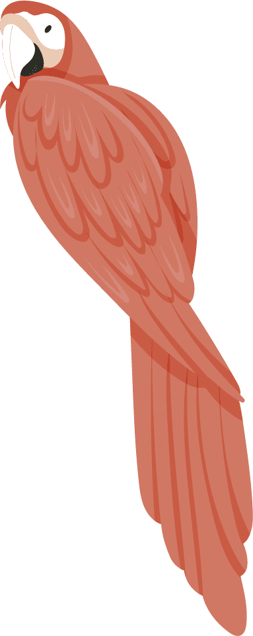





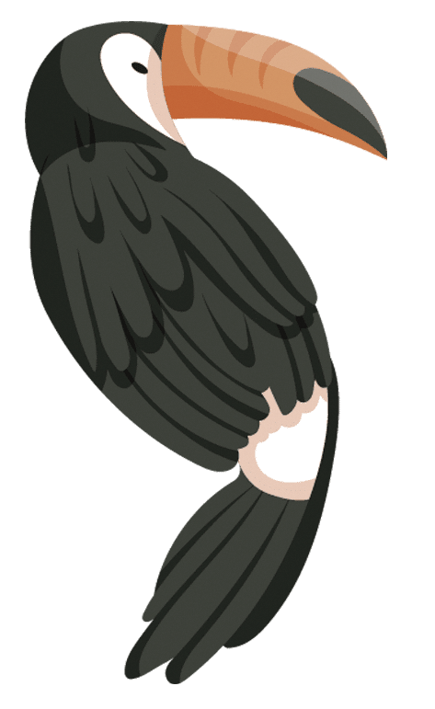

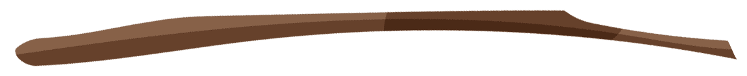
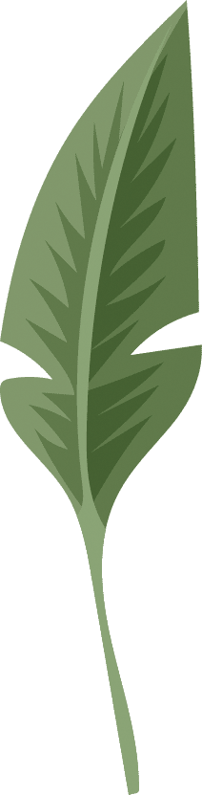
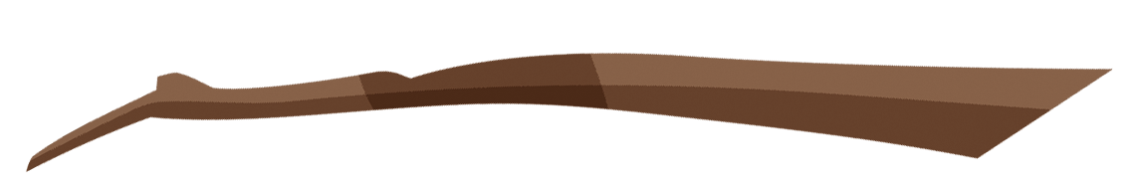
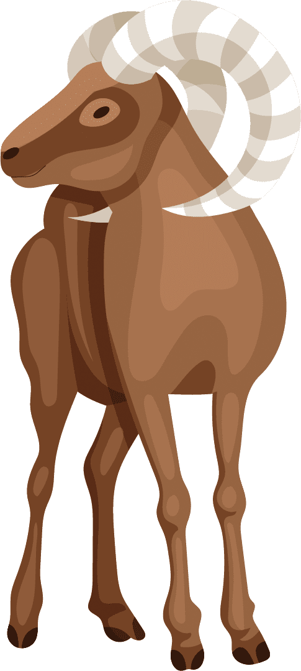




Animals Classification
Using supervised machine learning models
Michael M.
Daniel M.
Anthony H.
Lara B.

Slide 2



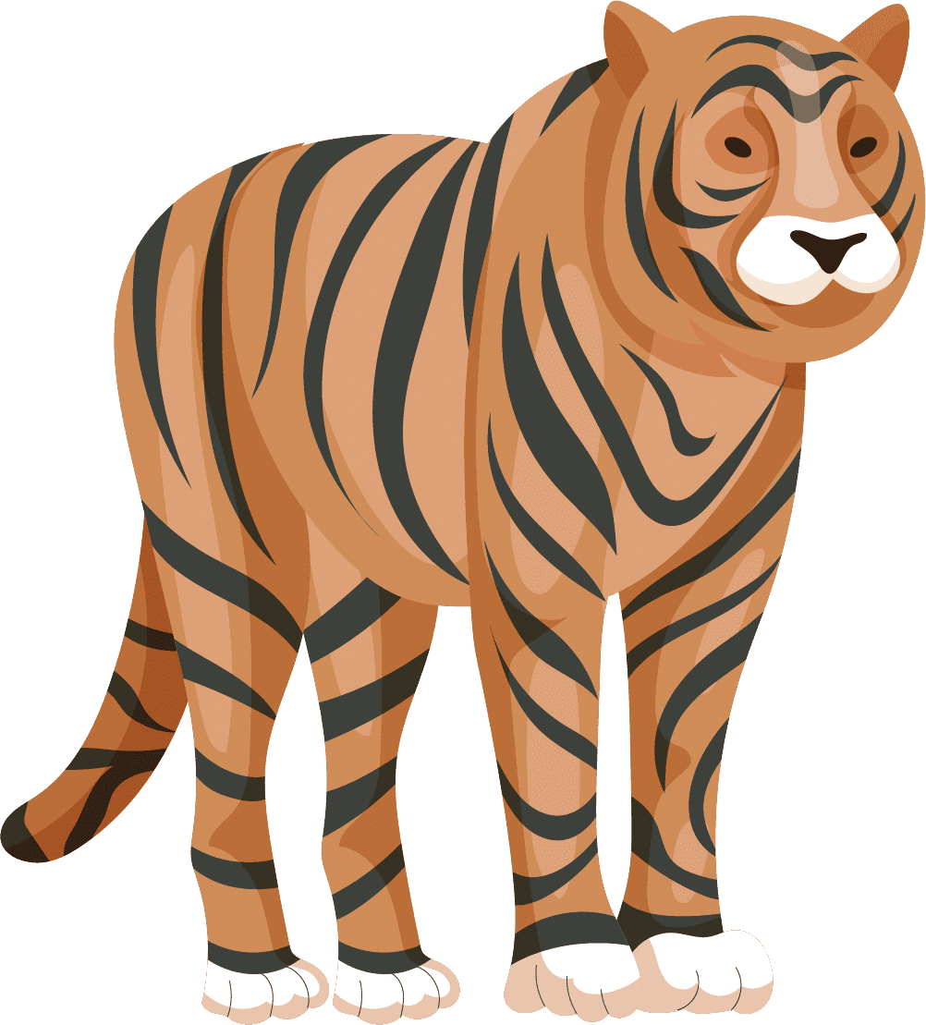

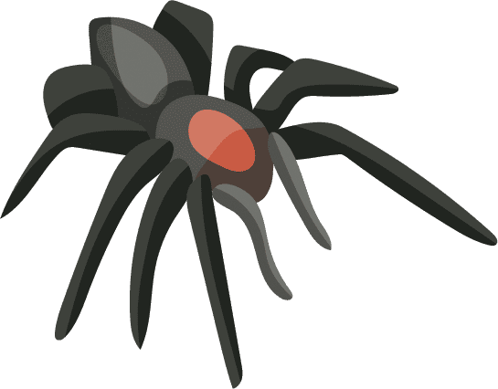
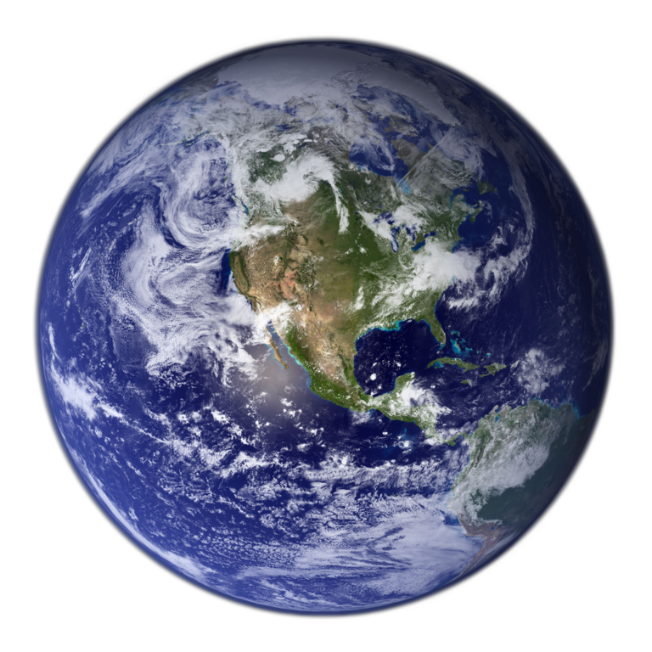
Purpose
With the data provided to us by TRAIN, we were requested to create machine learning models that can help predict animal classes based on their traits.
Goal: To develop a user-friendly system that aids the zookeepers and other animal enthusiasts in classifying animals so that they can learn about them, and care for them accordingly.
(Totally Real Animal International Network)

Slide 3
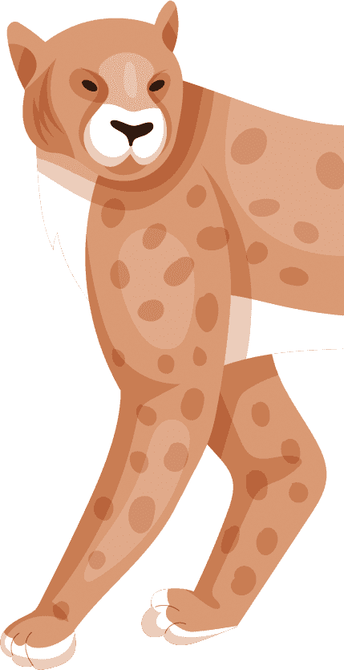
Data
Actual data source:
2 datasets from Kaggle
1 generated by Chatgpt
In total:
277 records
18 columns.

Slide 4
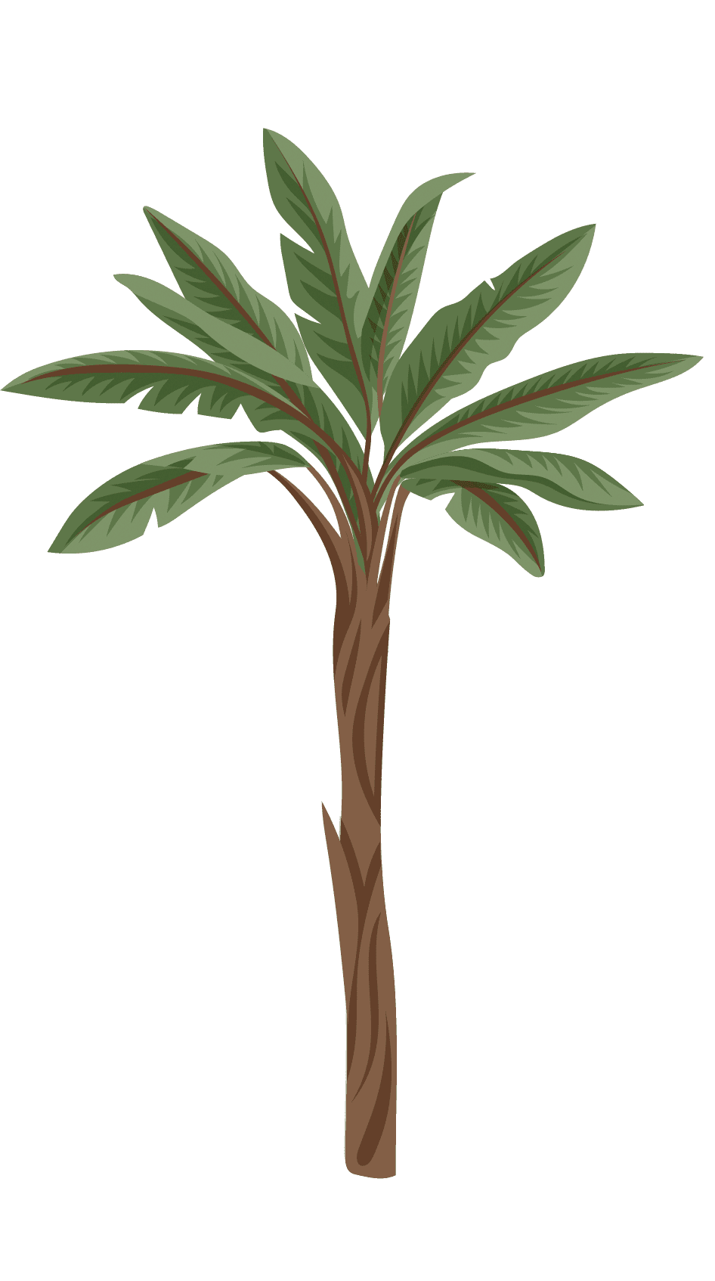
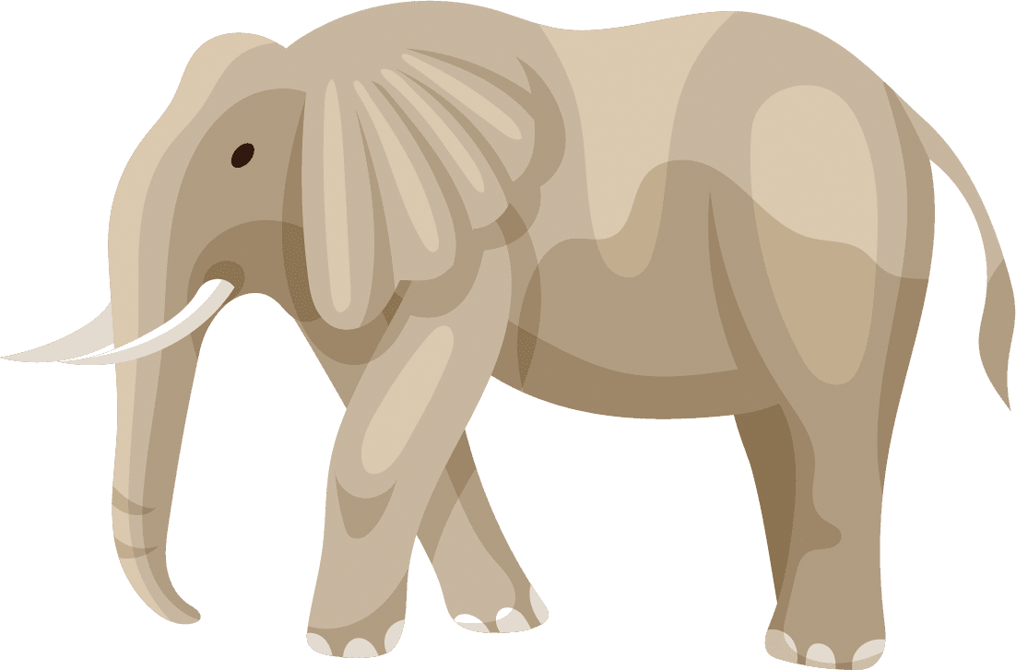

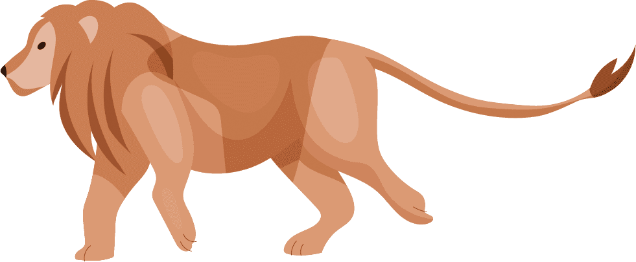
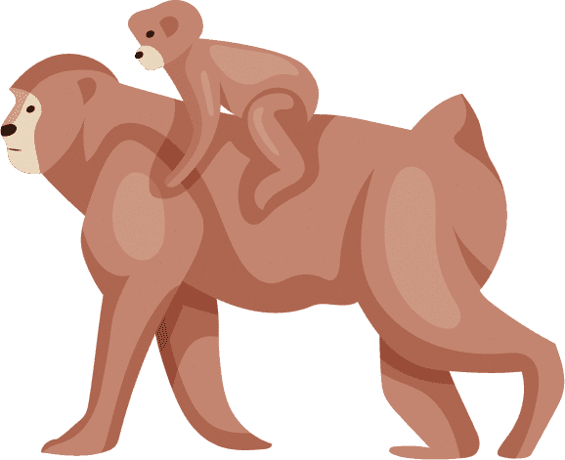
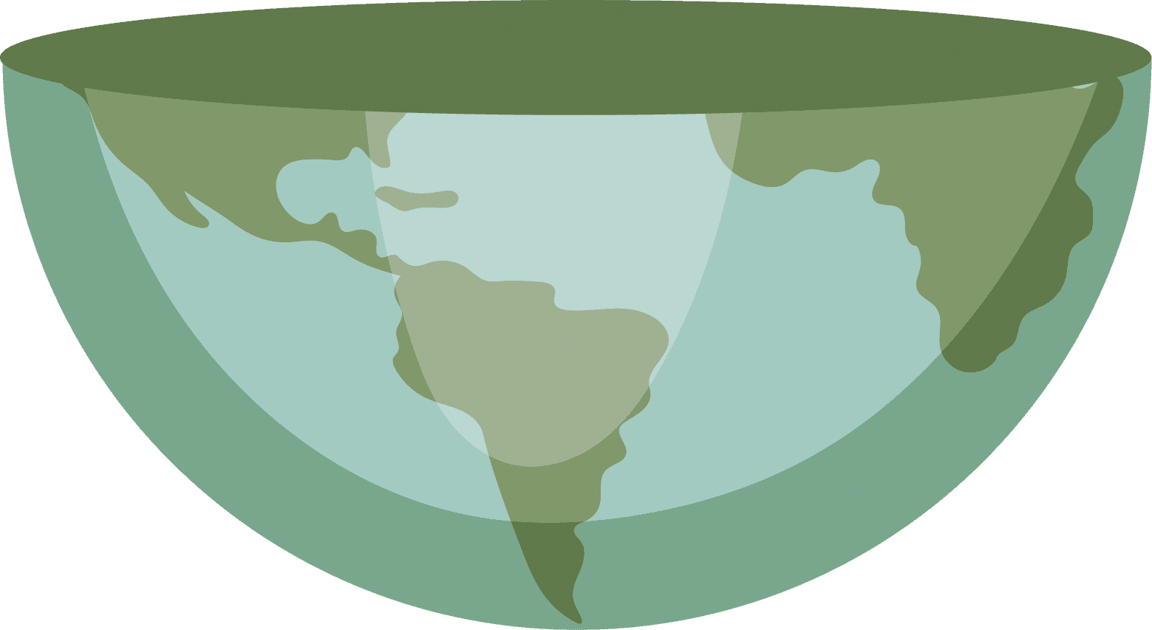
Data Wrangling
Dropped duplicates
Renamed and reordered columns
Changed the columns datatype
Dropped irrelevant columns
Added new columns and rows
Merged three datasets together

Slide 5

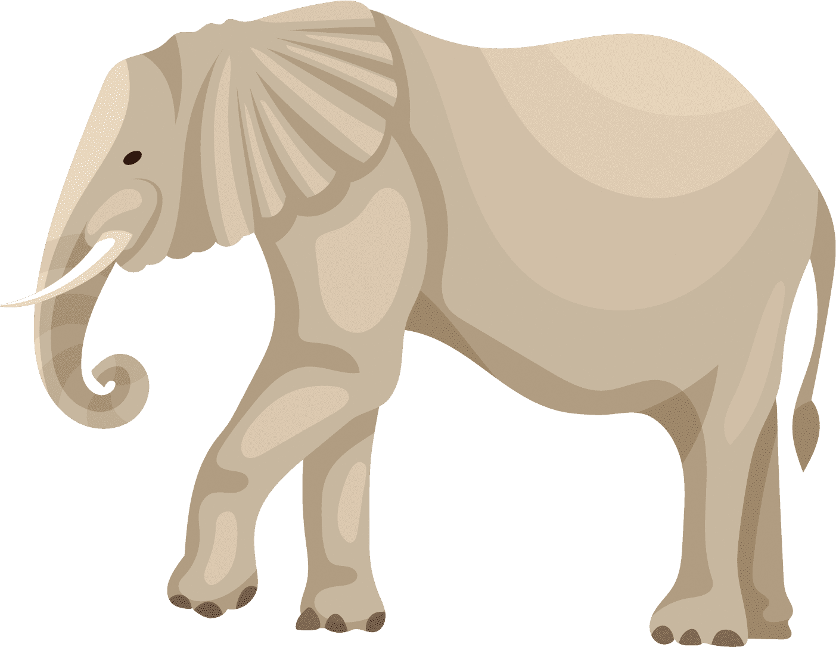

ML Models
Decision Tree
Support Vector Machine (SVM) with linear kernel
X: 15 features (milk, fins, feather, hair, toothed, tail, etc.)
Y: the animal class column
Same preprocessing technique applied for both models.
from scikit-learn:
StandardScaler()to standardize the features
train_test_split() function to split
80% of the data for training
20% of the data for testing

Slide 6
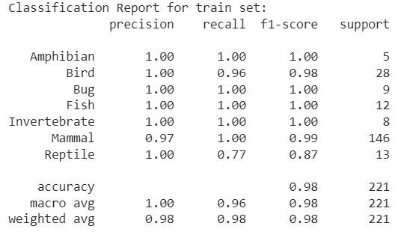
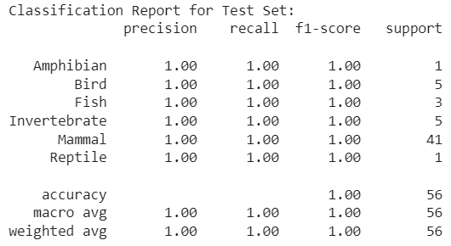
Decision Tree Report
DT model performed with high accuracy and precision.
The testing set performed slightly better than the training set, possibly due to the difference in the size of data designated for each set
Notes:
Since we designated 20% of the dataset for testing, the model had 56 instances to evaluate, mostly of which where mammals.
only 20% of the actual instances of "invertebrates" were correctly identified by the model

Slide 7
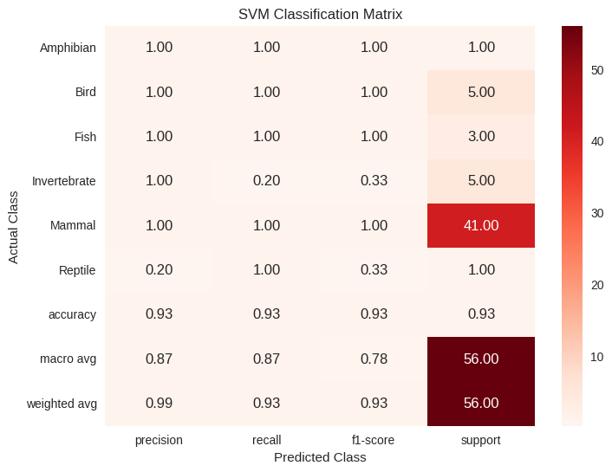
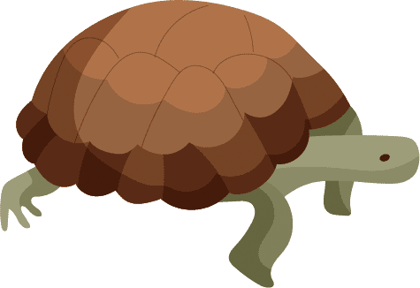
SVM Classification Report
SVM performed with slightly less accuracy and precision than the DT model.
Model was least precise in predicting reptiles.
Only 20% of the actual instances of "invertebrates" were correctly identified by the model
Notes:
Since we designated 20% of the dataset for testing, the model had 56 instances to evaluate, mostly of which where mammals.

Slide 8
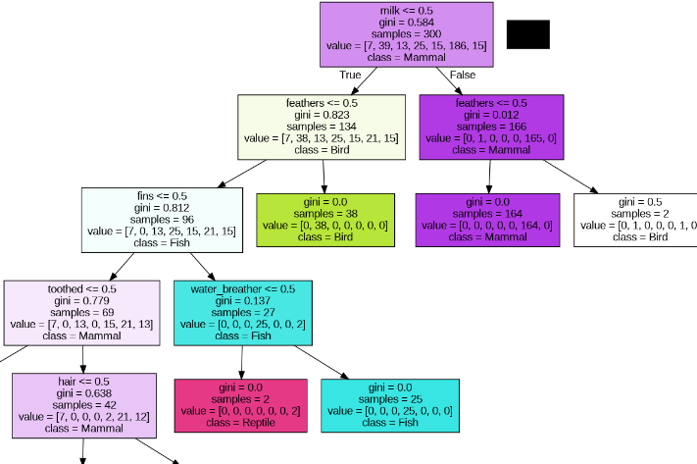
Decision Tree Graph
Visualization of the decision boundaries created by the decision tree model.

Slide 9
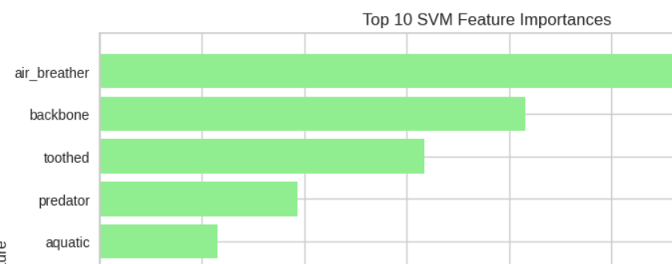
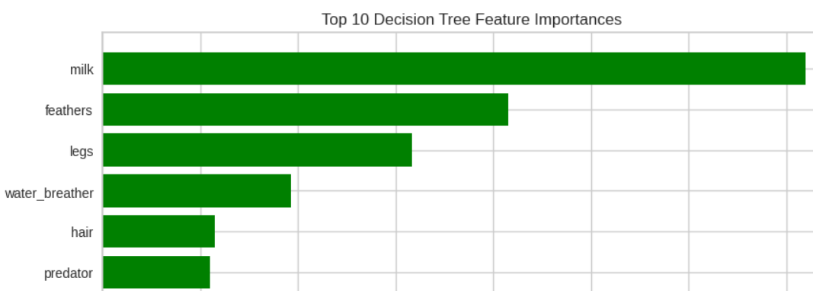
Feature Importance Visualizations
Used matplotlib to visualize the features by their importance
SVM considered air-breather as the most important feature
Decision Tree considered milk as the most important feature
The 2 models learn from data using different approaches, leading to the variation in feature importance.

Slide 10


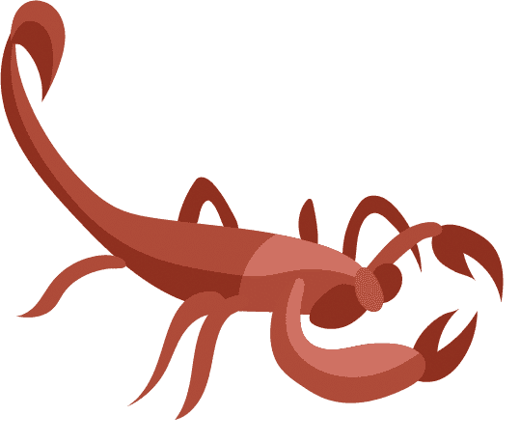
PyCaret
We used the PyCaret library to efficiently experiment with different ML models.
We were able to compare 9 different models, one of which we attempted to deploy!

Slide 11

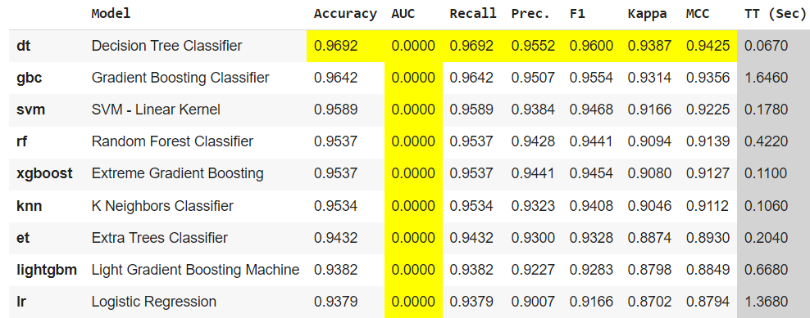
PyCaret
Example of how PyCaret compared the best models for our data.

Slide 12
From model to production
Persisted the trained DT model into a pickle file using joblib.
Created a web application on the model using the Flask framework.
Currently, app can run on a local computer.
Out all requests and results into a log file for inspection and optimization
Next Step:
To deploy our Flask app to a Web server like AWS.

Slide 13

Let’s show you our attempt in deploying the ML model into production!

Slide 14

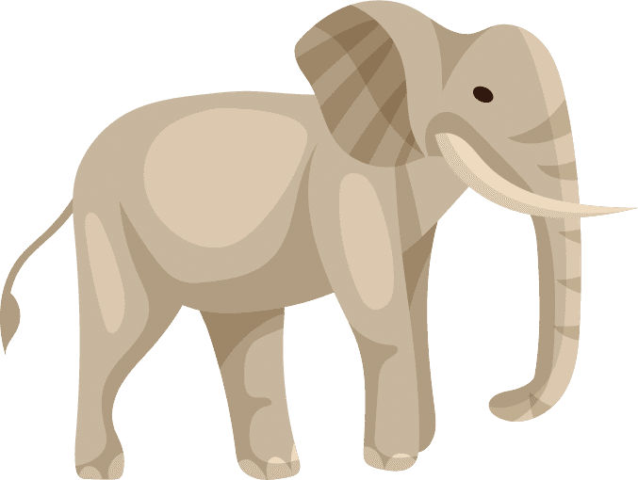

Final Thoughts
Animal classification can be accurately and reliably predicted by ML algorithms.
Decision Tree outperformed the SVM model.
PyCaret is a useful tool in automatically comparing different ML models.
Deploying a ML model is as important as building one.
We hope TRAIN can put our model into good use in the mammal world!

Slide 15
References
Data Source: https://www.kaggle.com/datasets/uciml/zoo-animal-classification/code
OpenAI. (2024). ChatGPT [Computer software]. Retrieved from https://www.openai.com/chatgpt
Slides Template Source: www.slideegg.com

